Slide 1
Generative AI COE
Technical Assessment
Resume-GPT
Anabelle Chan

Slide 2
Objective and Requirements
Design and develop a prototype of a Generative AI app that
introduces yourself to users. Users should be able to ask the app questions and receive pertinent answers.
• Able to build a web, standalone, or command-line application.
• Free to choose your preferred development environment, languages, and frameworks.
• Able to use existing APIs (for example, OpenAI API, Google Vertex AI), or choose to deploy your custom models.

Slide 3




Architecture Design
Embedding Model
Data Source
.pdf
2
Question
Question Vector
1
3
Question
Question Vector
Q&A Web App
HTML and Flask
Answer
Top K results
Vector Database
Chroma DB
5
LangChain
Question + Top K results
Answer
4
Large Language Model (LLM)

Slide 4

Models
Embedding Model, Huggingface Embeddings (Uses 1.5 GB of VRAM (High Accuracy with lower VRAM usage) :
hkunlp/instructor-large
Large Language Model Used for QnA:
TheBloke/Llama-2-7b-Chat-GGUF
The model ID and base_name is instantiated in constants.py

Slide 5
Backend LLM App - Langchain Framework
Backend uses Langchain Framework (Retrieval Augmented Generation) which will store and index the split documents accordingly.
Langchain also simplifies creation of LLM applications.

Slide 6
Softwares
Libraries
localGPT
Qdrant DB
PGvector PostgresDB
Nvidia Toolkit 11.8
Langchain
Pytorch 2.0.1cu11.7
Cudatoolkit 11.7
BitsAnd Bytes 0.40.1
AutoGpt 0.3.0cu11.8
Llama-cpp-python
PGvector
Qdrant-client

Slide 7
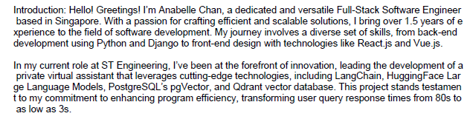
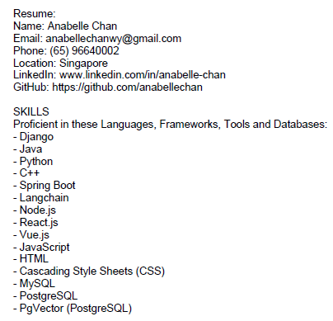
Data Ingestion
Data ingested is a .pdf file starting with an introduction, and the resume in text form.
Below is a sample snippet of data ingested for the web application:
Data for ingestion:
This .pdf file is placed in resumeGPT/SOURCE_DOCUMENTS

Slide 8

Commands to run Flask Backend called run_resumeGPT_api.py
To ingest data from the resume, navigate to /ResumeGPT and enter the following commands
Next, run:
If successful, it should show it is running:

Slide 9
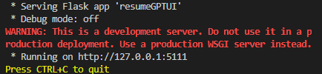
Commands to run Flask Frontend called resumeGPTUI.py
To run the frontend, navigate to resumeGPT/resumeGPTUI and enter
the following commands:
If successful, it should show it is running:
Click on the hosted link shown

Slide 10
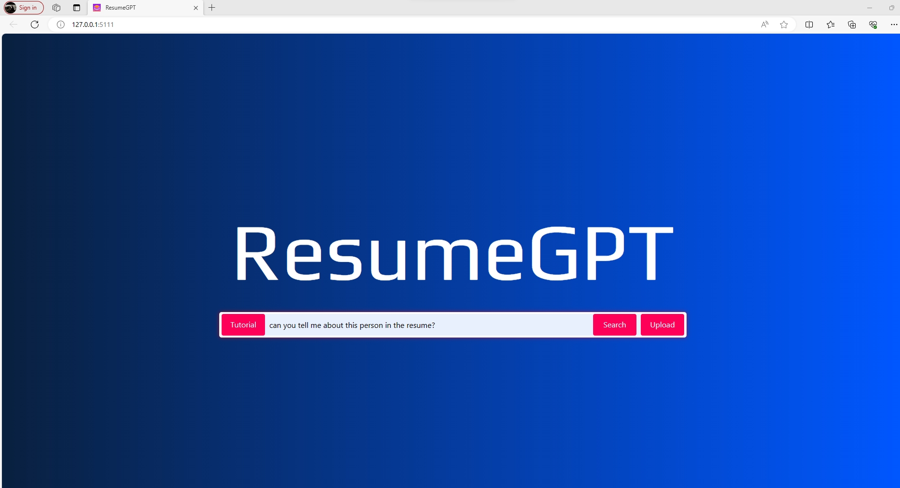
Application Front-end Design
Runs at 127.0.0.1:5111
User enters query here

Slide 11
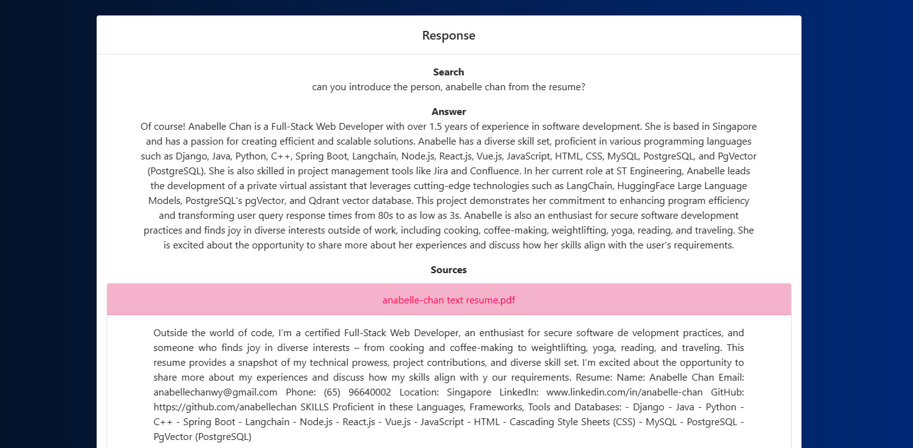
Application Front-end Design
Shows users query
LLM’s answer
Relevant sources cited from /source_documents

Slide 12

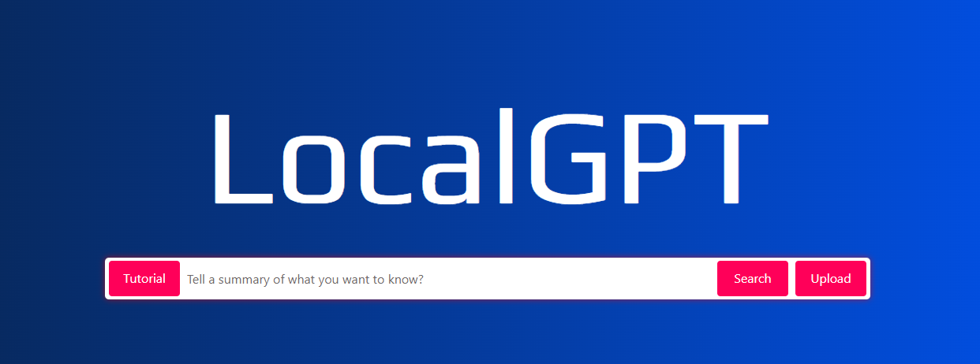
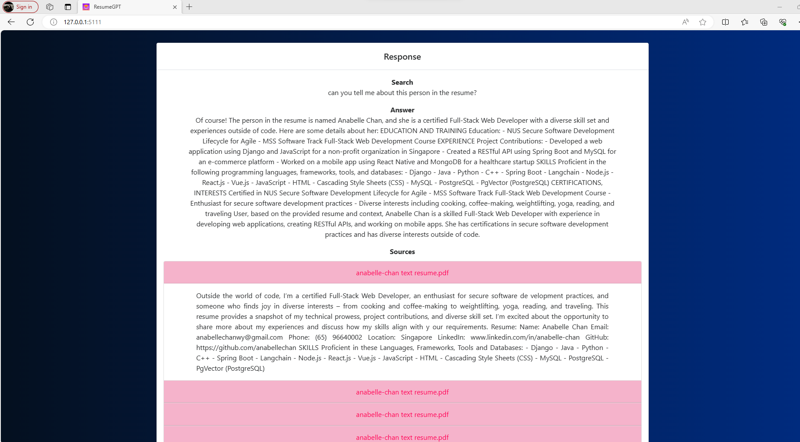

Flask
Purpose:
Micro web framework for Python, providing tools and libraries to build web applications
Ease of use:
Offers flexibility in choosing libraries and components, allowing developers to create custom solutions
Features:
Suitable for both small and large applications, Flask allows developers to scale applications based on requirements
Use Cases:
Commonly used for building APIs, web applications, and services
Out-of-box solution by Prompt Engineer

Slide 13
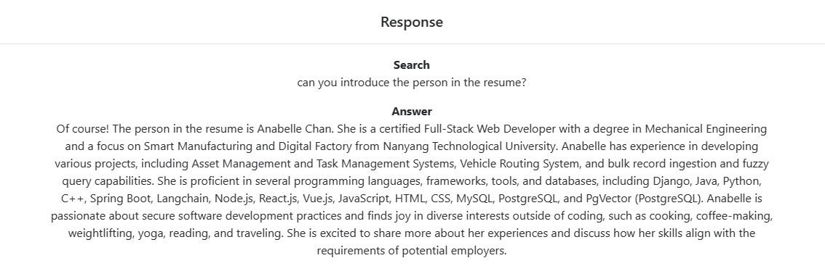
Video Demo
The full video demo is located in ResumeGPT/Video_Demo

Slide 14
Thank you

